Slide 1

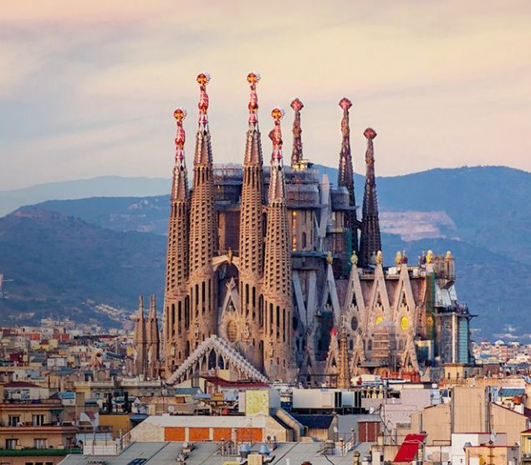
The
City of Barcelona
Students: Anahita Esfandiaryfard
Biagio Incardona
Academic Year 2020 - 2021

Slide 2

Starting dataset

Slide 3
From the data source https://www.kaggle.com/xvivancos/barcelona-data-sets, 13 tables in "csv" format have been selected:
Accidents_2017 table (10335 records): Contains List of accidents handled by the local police in the city of Barcelona in 2017. | Air_quality_Nov2017 table (8 records): Contains measure data for air quality in 2017.
Air_stations_Nov2017 table (8 records): Contains Main characteristics of the air quality measure stations. | Births table (734 record): Contains Births by nationalities and by neighborhoods of the city of Barcelona (2013-2017).
Bus_stops table (3162 records): Contains Bus stops, day bus stops, night bus stops, airport bus stops of the city of Barcelona(2013-2017). | Deaths table (4599 records): Contains Deaths by quinquennial ages and by neighborhoods of the city of Barcelona (2015-2017).
Immigrants_by_nationality table (35200 records): Contains Immigrants by nationality and by neighborhoods of the city of Barcelona (2015-2017). | Immigrants_emigrants_by_age table (4662 records): Contains Immigrants and emigrants by quinquennial ages and by neighbourhood of the city of Barcelona (2015-2017).

Slide 4
Immigrants_emigrants_by_sex table (730 records): Contains Immigrants and emigrants by sex by neighborhoods of the city of Barcelona (2013-2017). | Life_expectancy table (73 records): Contains Life expectancy of the city of Barcelona (five years). 2006-2013
Population table (70000 records): Contains Population by neighbourhood, by quinquennial ages and by genre of the city of Barcelona (2013-2017). Reading registers of inhabitants. | Transports table (651 records): Contains Public transports (underground, Renfe, FGC, funicular, cable car, tramcar, etc) of the city of Barcelona.
Unemployment table (14200 records): Contains Registered unemployement by neighbourhood and genre in the city of Barcelona (2013-2017).

Slide 5
From the data source https://www.kaggle.com/marcvelmer/barcelona-accidents, Four tables in "csv" format have been selected to complete Accident table information of initial table:
2013_Accidents table
8612 records
2014_Accidents table
8777 records
2015_Accidents table
9104 records
2016_Accidents table
9344 records
From the data source https://opendata-ajuntament.barcelona.cat/data/en/dataset/poblacio-exposada-mapa-estrategic-soroll/resource/2a158068-414b-4dc1-940f-16c4bf03d2cd, one tables in "csv" format have been selected:
Acoustic noise table (2601 records): Contains the information of rang noise for each district.

Slide 6

Business Questions

Slide 7
Business Questions 1
The business questions to which the report aims to answer are:
Regarding Demographic:
How many people live in Barcelona and how is the distribution of these people in districts?
How did population change during years divided by gender?
Do people tend to have children?
How is the distribution of age of population?
How death is distributed across the age?
Regarding Life Quality:
At which level of noise pollution I can expect to live?
What is the air quality of the districts?
Which transportation is more accessible in the city?
Regarding Immigrants:
What is the number of immigrants in Barcelona?
What is most frequent nationality in Barcelona?
At what age people tend to migrate more to Barcelona?

Slide 8
Regarding Accidents:
In what hour number of accidents are higher?
Is the number of accidents different at weekends?
Is the number of accidents changed over the years?
In which month number of accidents are higher?
In what district more accidents happen?
Regarding Unemployment:
What is the unemployment rate in Barcelona
How did the unemployment rate change during the years?
Does Women have an higher unemployment rate than men?
What district has a higher/lower unemployment rate?
Regarding Life expectancy:
How much is life expectancy in city of Barcelona?
Do women live more than men in Barcelona?
How life expectancy change in each district?
Is there a district with a better life expectancy?
How life expectancy changed during years?
Business Questions 2

Slide 9
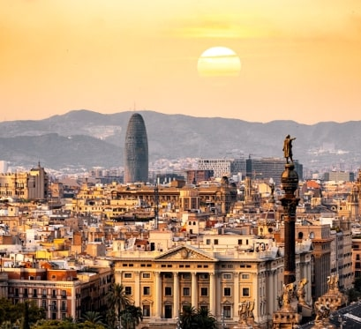
Dimensional Fact Model DFM

Slide 10
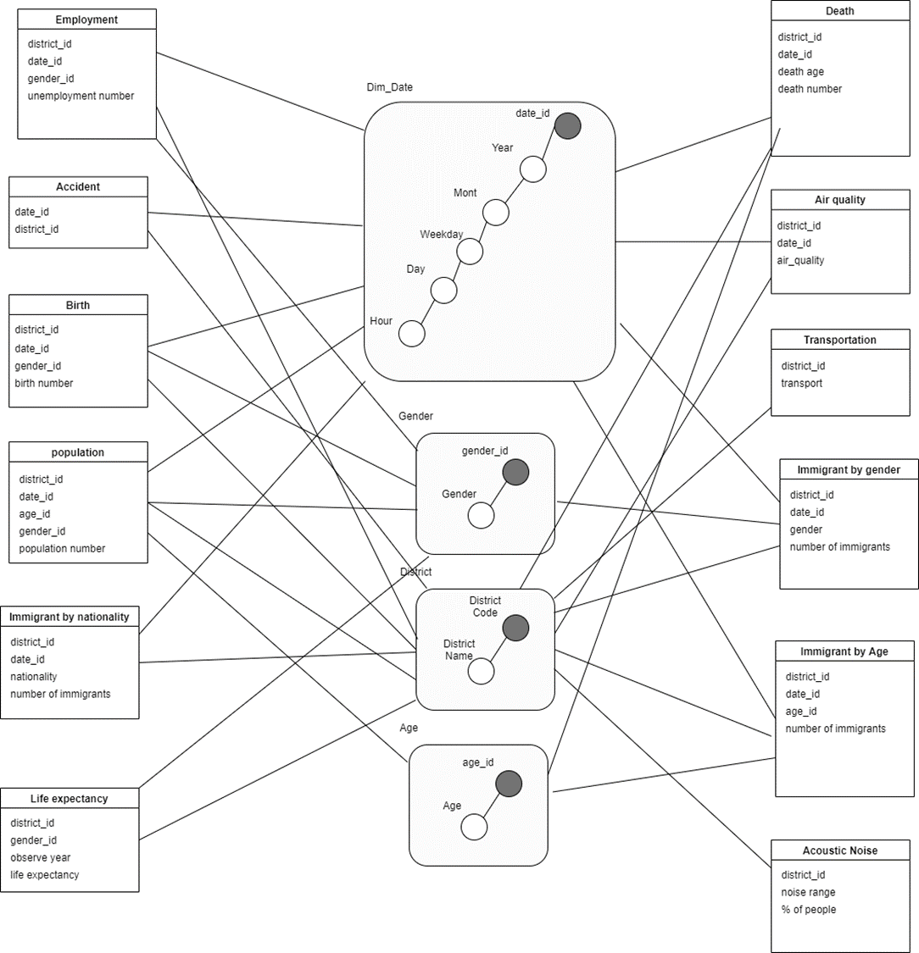
The relationships among the dimensional attributes are expressed by hierarchies. The functional dependencies are:
• For dateid:
dateid→year→month→weekday→day→hour
• For districtid:
districtid→districtname
• For genderid:
genderid→gender
• For ageid:
ageid→age
Dimensional Fact Model

Slide 11

ETL Process

Slide 12
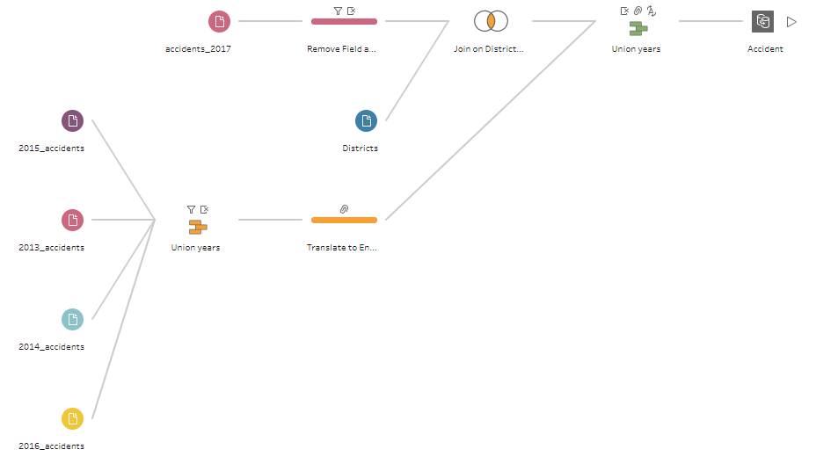

Slide 13
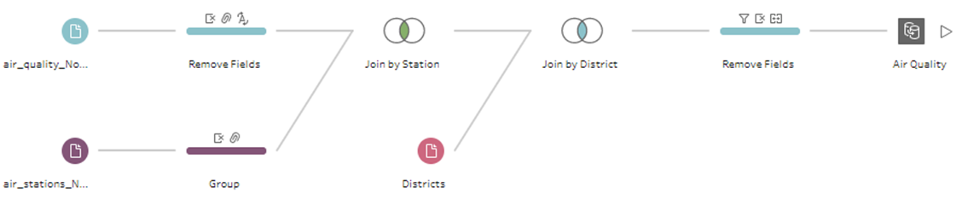
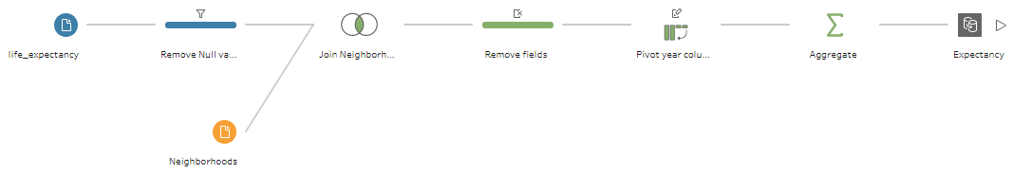
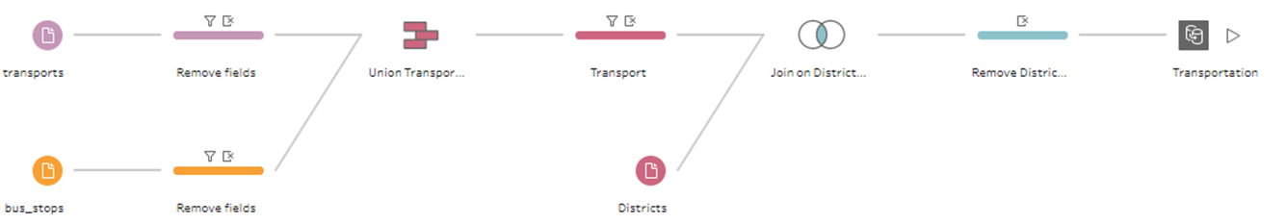

Slide 14
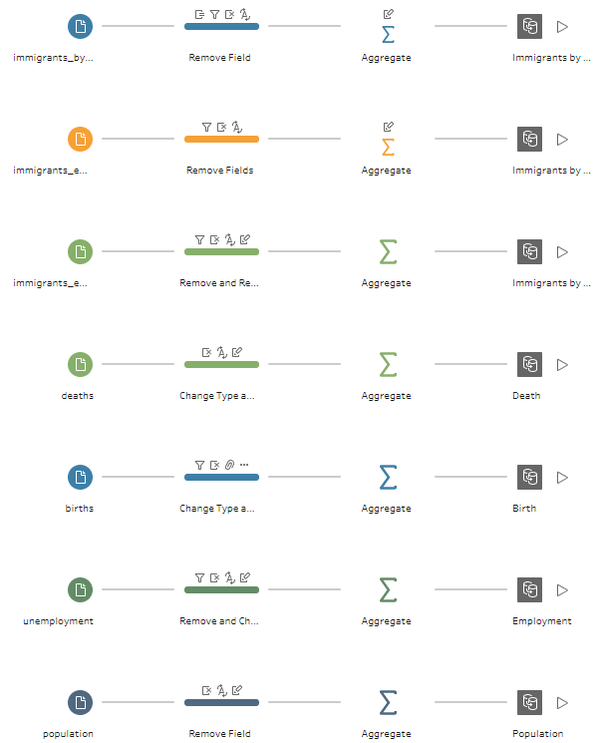
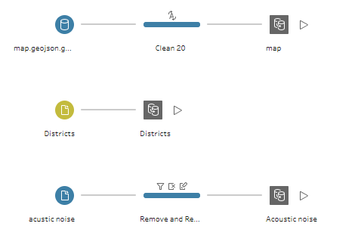

Slide 15
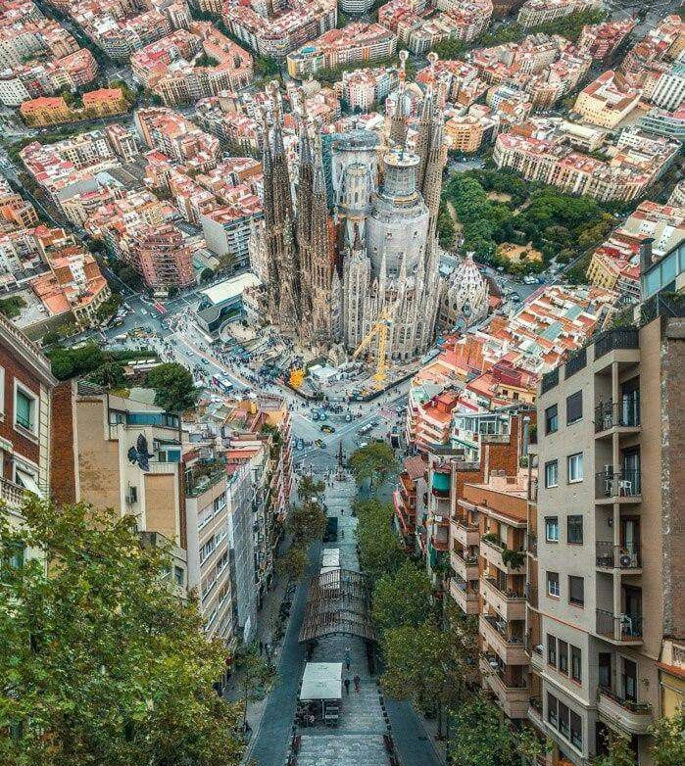
Charts & Dashboards

Slide 16
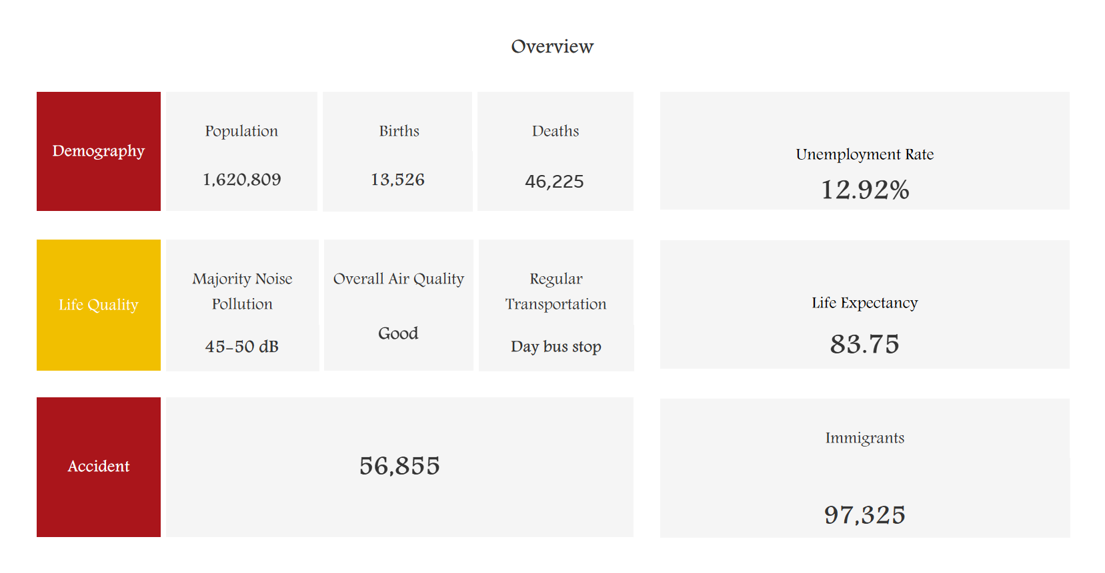
Overview Dashboard
The dashboard has the goal of representing main information of the dataset
Clicking each info bring you related dashboard to have better view on details

Slide 17
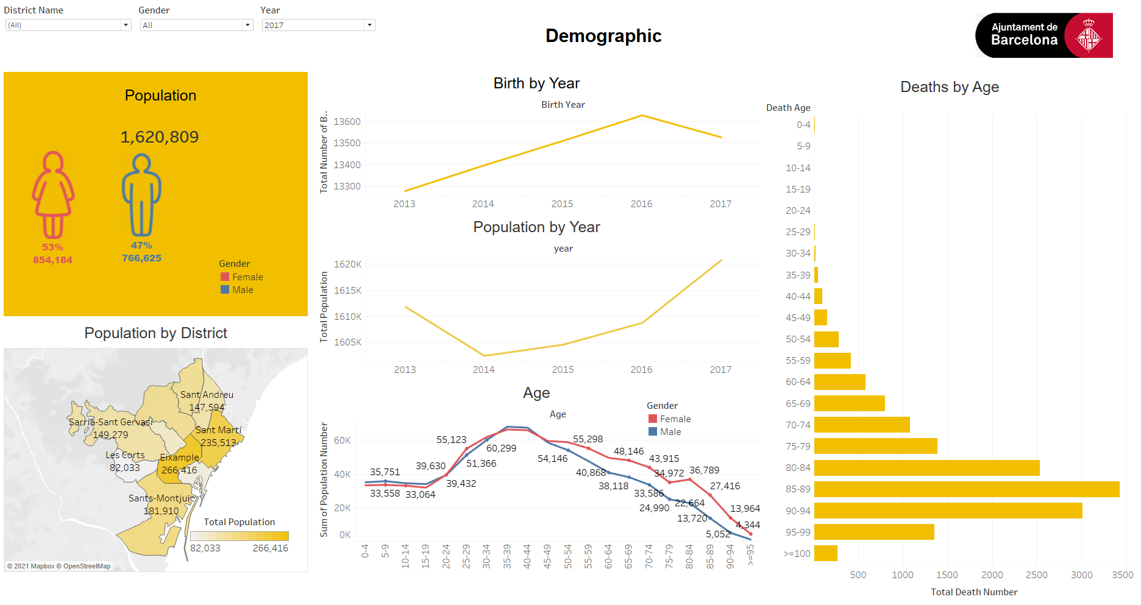
Demographic Dashboard
The demographic dashboard, aims to giving information about the number of citizens, how they are distributed across the districts of the city, but also how the population is changing overtime and if there is a generational renewal.
Dashboard contains:
The Filters, filter the whole dashboard per District, gender and year.
The image contains the Logo of Barcelona and can act like a button that can send the user directly to the overview dashboard.
6 Charts that will be discussed later

Slide 18
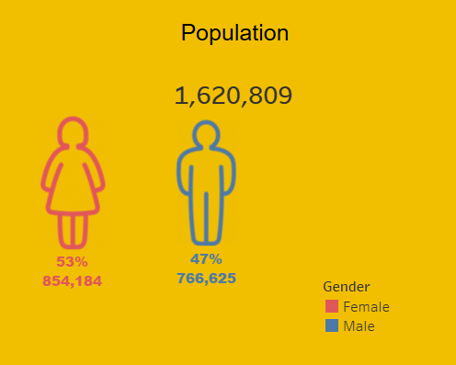
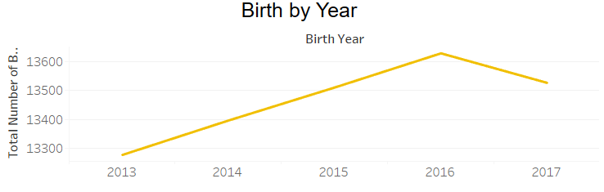
Population
Birth by Year
This chart is a KPI that shows up the total amount of population and how they are distributed across the gender.
This chart consists of a line chart that shows how the number of births changed over the years.

Slide 19
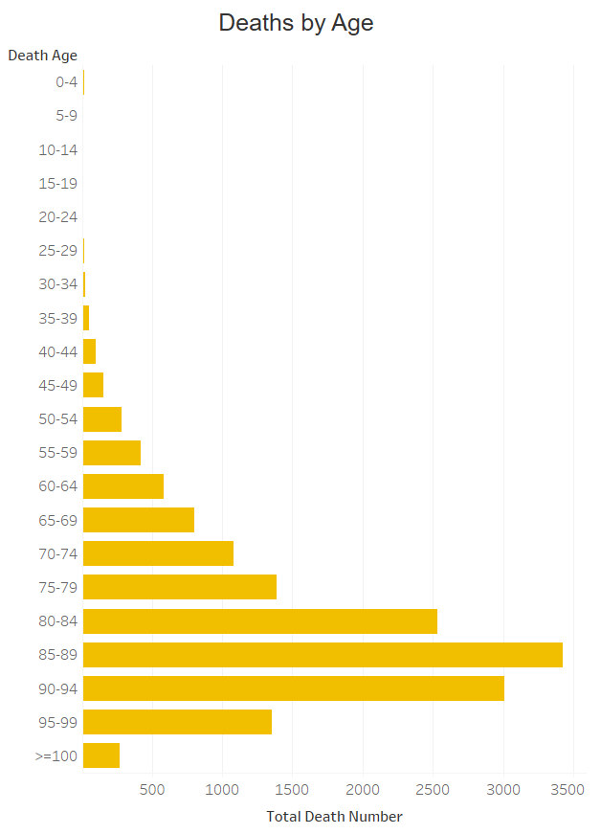
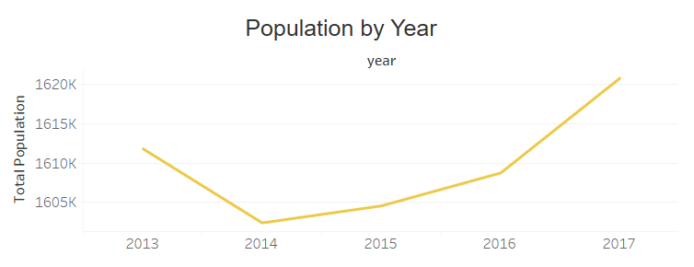
Death by Age
Population by Year
With this chart the distribution of deaths in the city is shown.
This line chart has the goal to show how the amount of population has changed during the last years

Slide 20
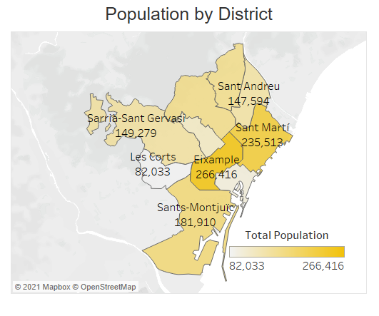
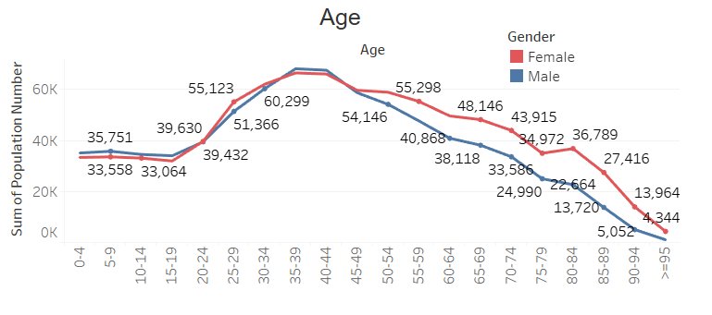
Population by District
Age
A map is used to identify the population living in each Barcelona district. The more intense the color the more populate the district is.
This chart consists of two line plots, one per gender (pink: female, blue: male), analyzing the ages distribution of the citizens of Barcelona. In addition a filter actionist added in this plot that will allow to filter some of the chart in the dashboard(Population, Population by Year and Population by district) by the age.

Slide 21
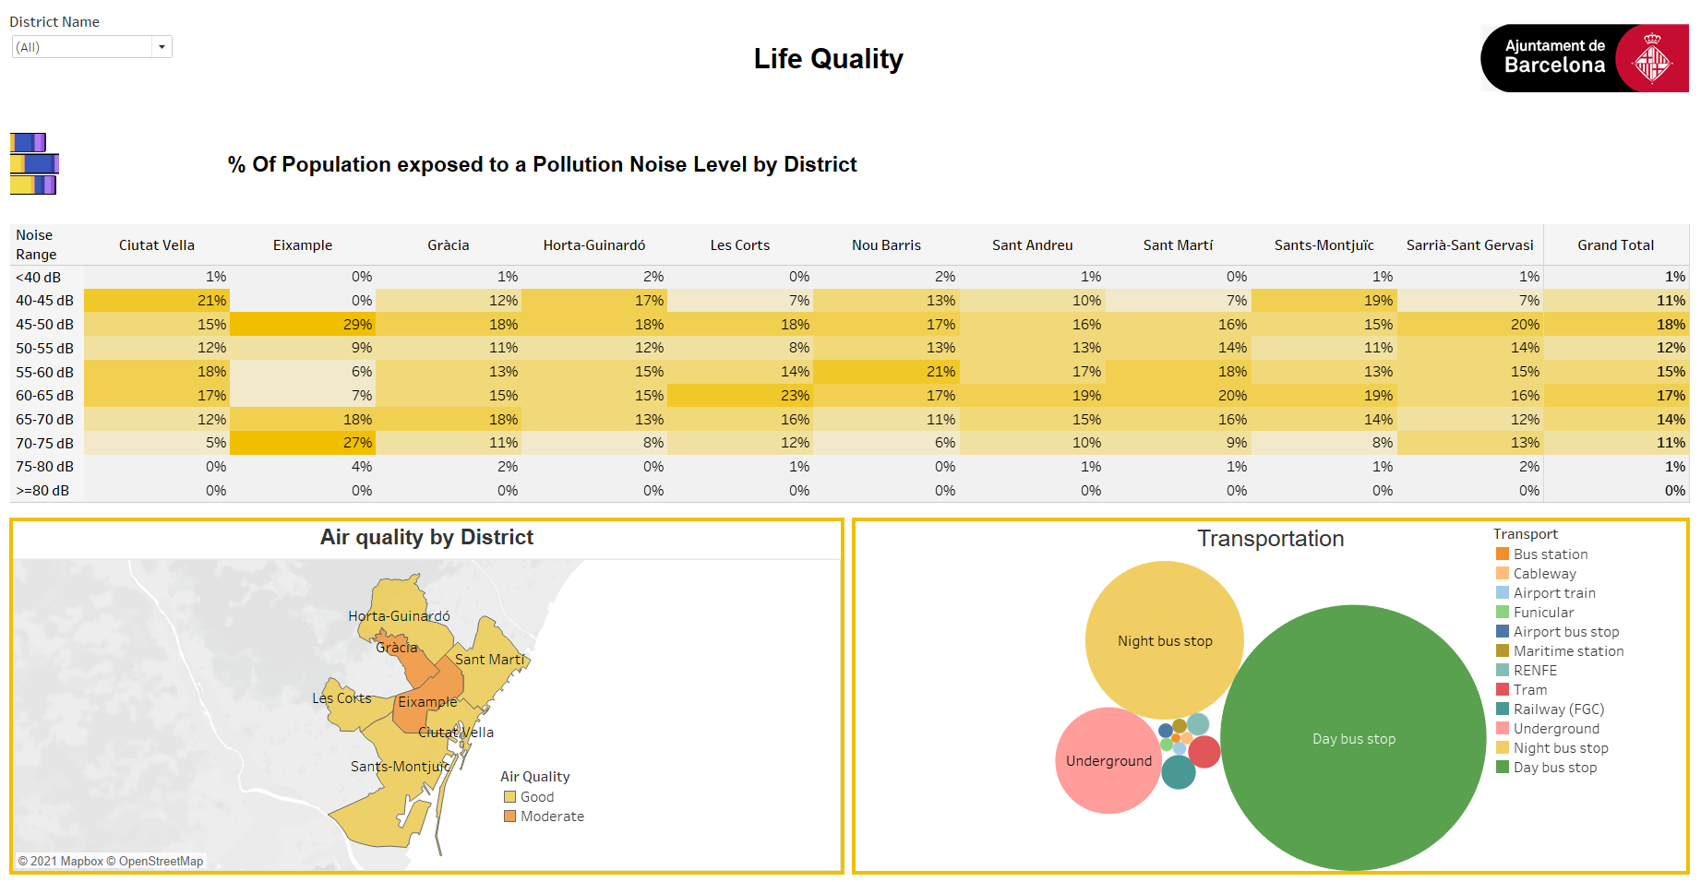
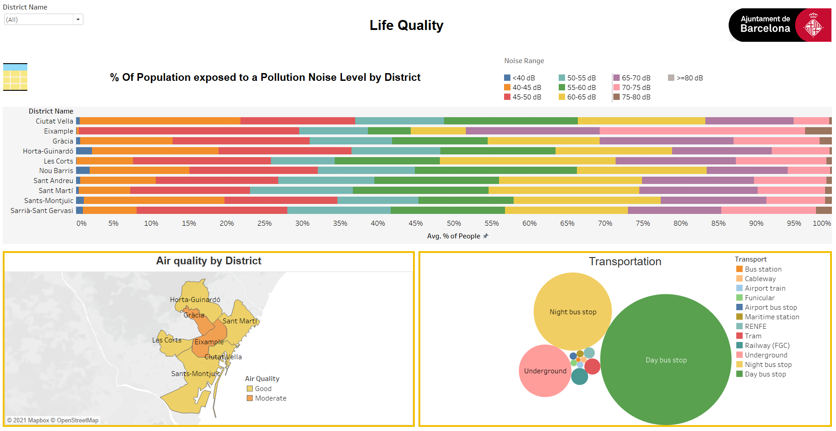
Life Quality Dashboard
Life quality dashboard with table
This dashboard has the goal to analyze the quality of life in the city.
In this dashboard there are three (maybe four) charts:
one drop down menu, used to filter all the charts by the district
A new button that in the beginning takes the shape of a bar chart and then, when clicked, it changes the table chart into a 100% stacked bar chart
Life quality dashboard with 100% stacked bar chart

Slide 22
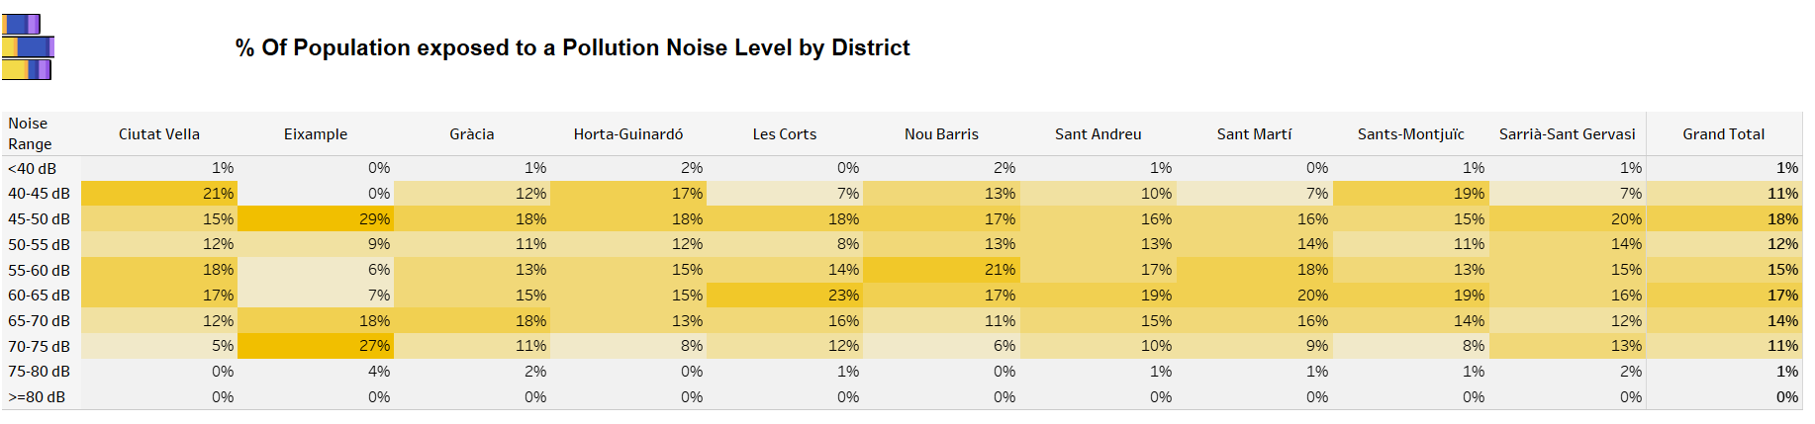
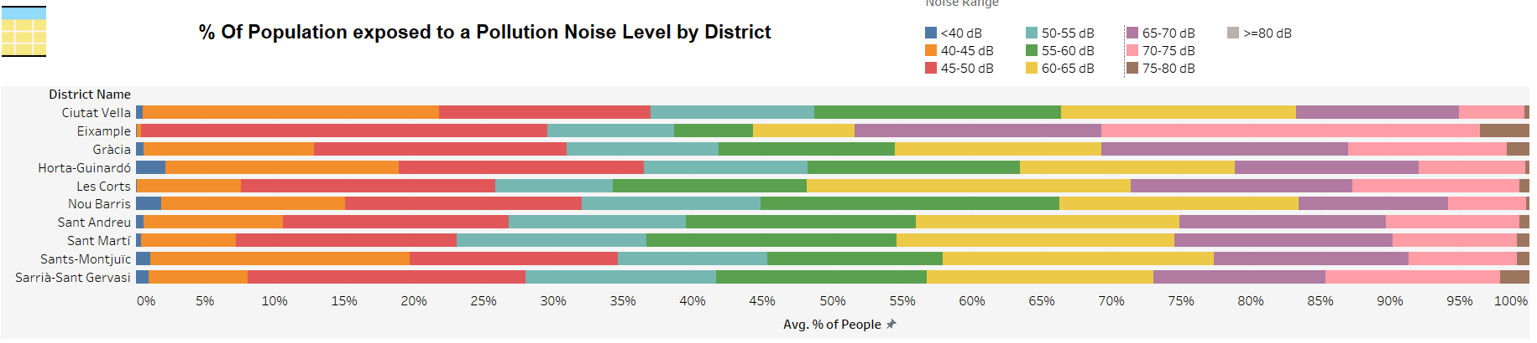
% Of Population exposed to a Pollution Noise Level by District
These two charts show exactly the same information but in a really different way. The table has the districts as columns, the noise pollution level as rows and each cell contains the percentage of people in a district exposed to a certain pollution level. The other plot is composed by ten bars, one for each district and it is composed by the percentage of people exposed to a certain pollution level, the pollution level is identified by the colors.

Slide 23
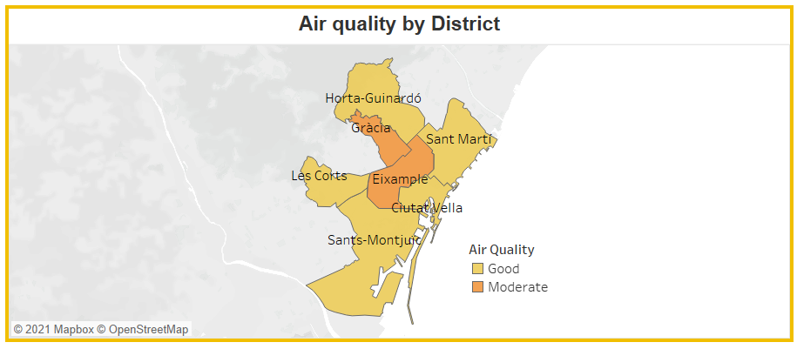
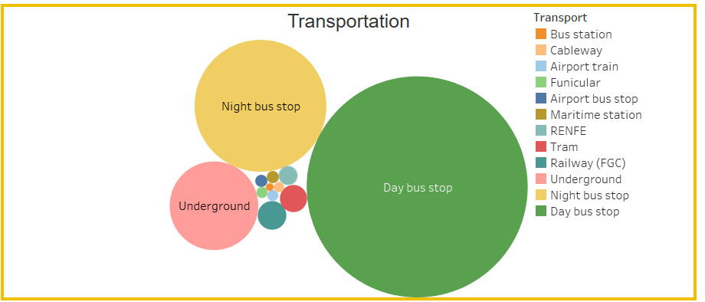
Air quality by district
Transportation
In this visualization a map is used to visualize what is the worst air quality relieved in the year 2017, in addition an action filter was added in order to easily analyze all the other charts in the dashboard.
This bubble chart analyze the quantity of vehicles for the different types of transportation, the size of each bubble is identified by that quantity (the bigger the bubble the more vehicles of that type are available).

Slide 24
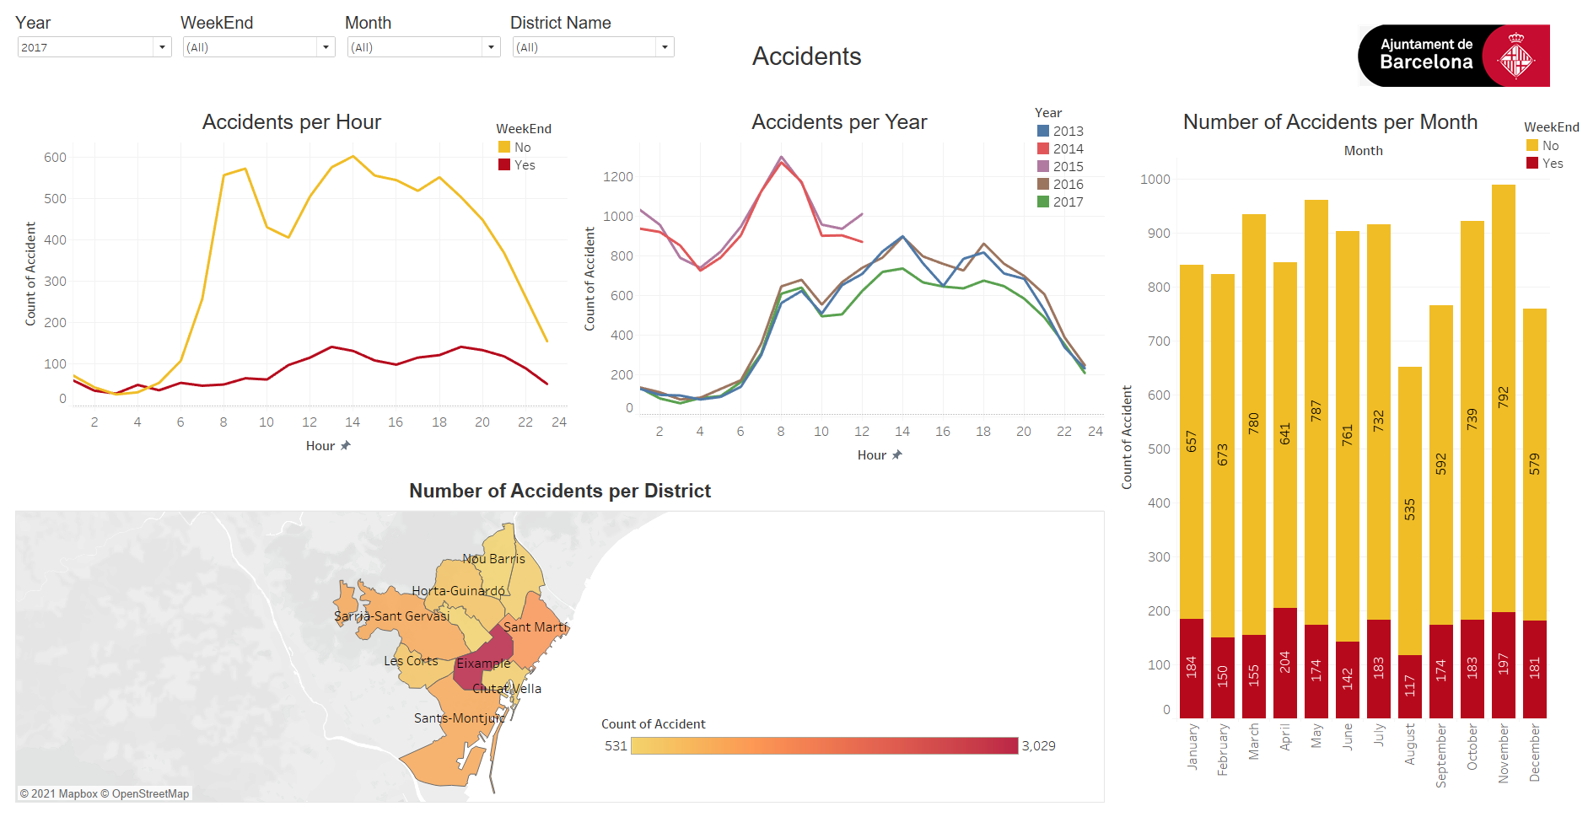
Accidents Dashboard
The Accidents Dashboard have the main goal to give a clear understanding of the accidents that happens in Barcelona.
Dashboard contains:
The Filters, filter the whole dashboard per District, weekend and month.
The image contains the Logo of Barcelona and can act like a button that can send the user directly to the overview dashboard.
4 Charts that will be discussed later

Slide 25
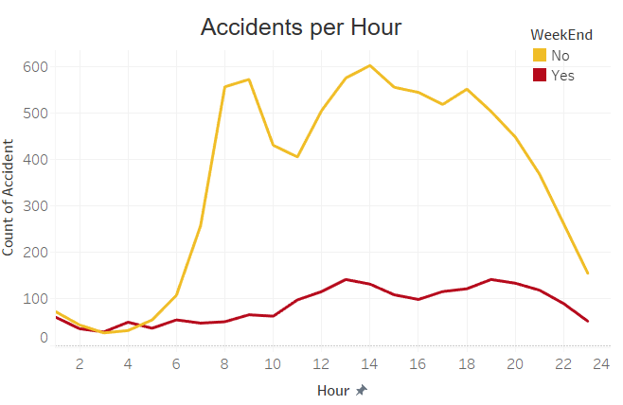
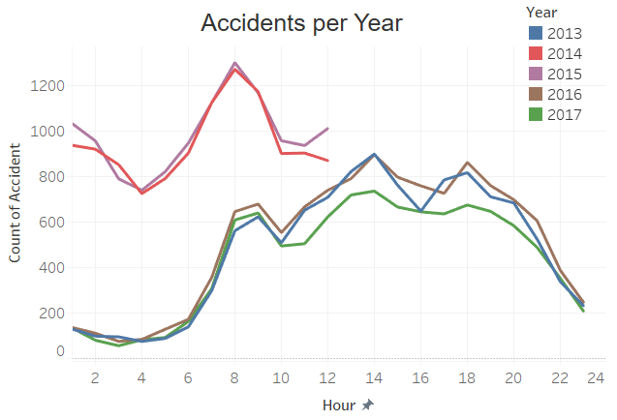
Accidents per Hour
Accidents per Year
The accidents per hour visualization is a line chart that identify how the accidents of a particular year are distributed during the day hours, with a further separation between the weekend and the work days.
This visual allow to give a direct look in how the accidents distribution is changed over the years.

Slide 26
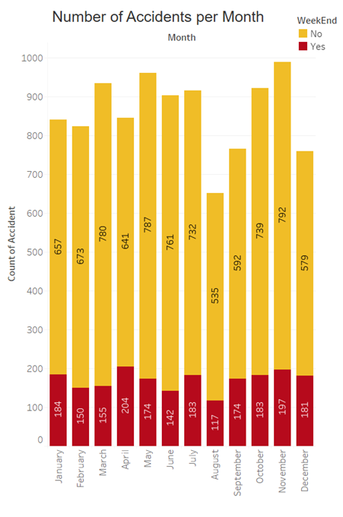
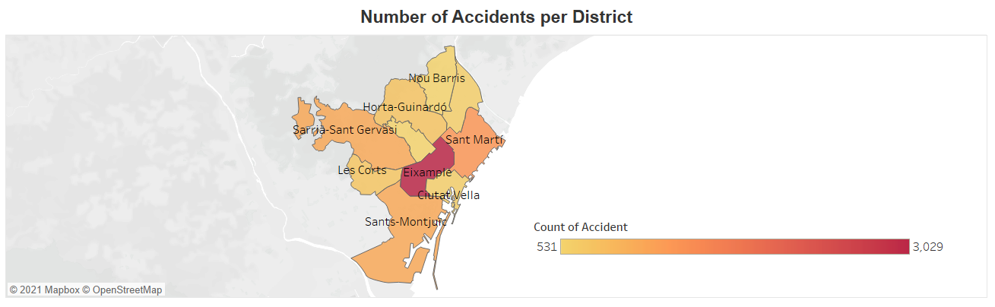
Number of accidents per Month
Number of Accidents per District
this chart shows the relationship between months and number of accidents, broke by the weekend measure.
In this visualization a map is used to visualize the amount of accidents per each district in the situation selected by the dropdown filters. The amount of accidents could be identified by the intensity of the color of each district (light yellow to dark red)

Slide 27
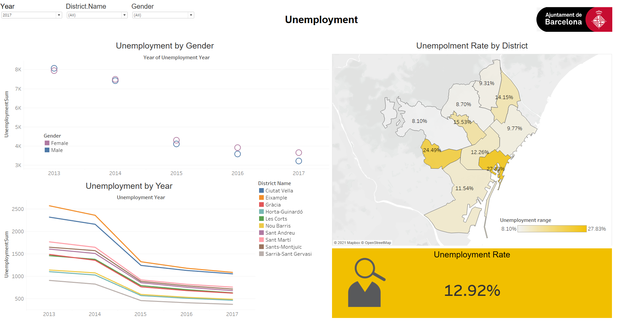
Unemployment Dashboard
The unemployment dashboard will focus only in analyzing the employment situation of the city, how the unemployment rate is changed over the years and how it changes between the districts of Barcelona.
Dashboard contains:
The Filters, filter the whole dashboard per District, Gender and Year.
The image contains the Logo of Barcelona and can act like a button that can send the user directly to the overview dashboard.

Slide 28
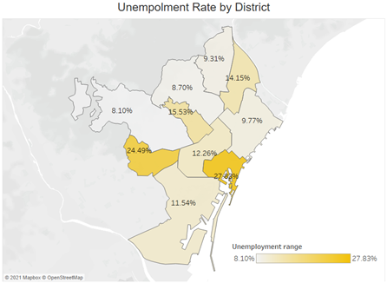
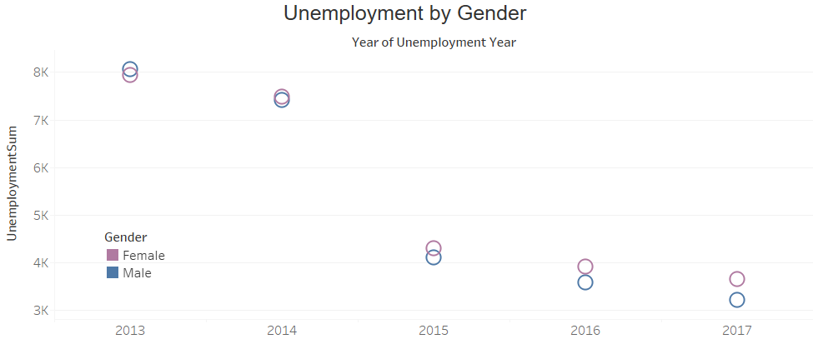
Unemployment by Gender
Unemployment Rate by District
This visualization shows number of unemployment during year and divided by gender
In this visualization a map is used to visualize the amount of unemployment per each district. The amount of unemployment could be identified by the intensity of the color of each district (light yellow to dark yellow)

Slide 29
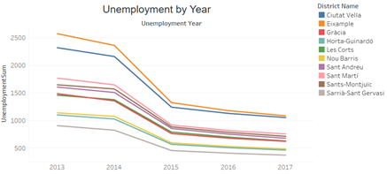

Unemployment by Year
Unemployment Rate
This visualization shows rate of unemployment during the year from 2013 to 2017.A legend for district names in the right corner helps to identify what color is related to what district
This KPI shows the percent rate of unemployment related to selected year

Slide 30
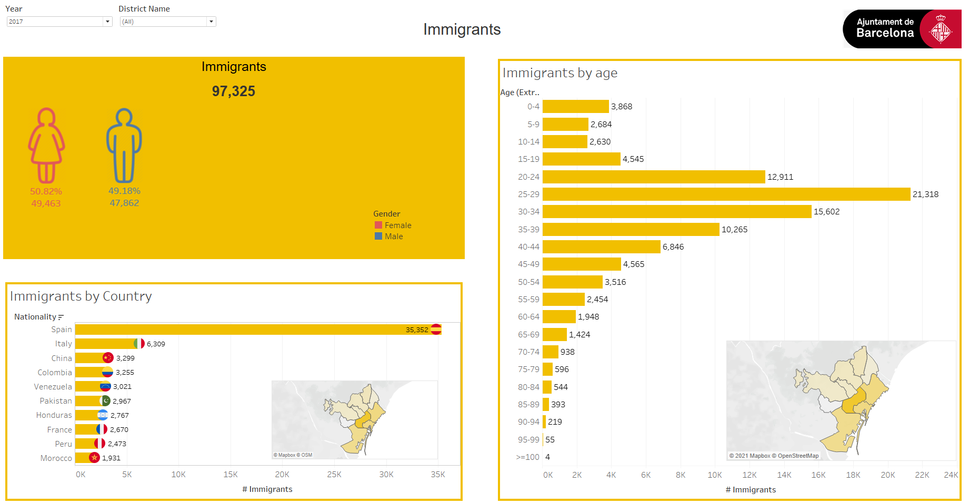
Immigrants Dashboard
The Immigrants Dashboard have the main goal to give a clear understanding of the number of that immigrants in Barcelona, during 2013 to 2017.
Dashboard contains:
The Filters, filter the whole dashboard per District, Year.
The image contains the Logo of Barcelona and can act like a button that can send the user directly to the overview dashboard.
3 Charts that will be discussed later

Slide 31
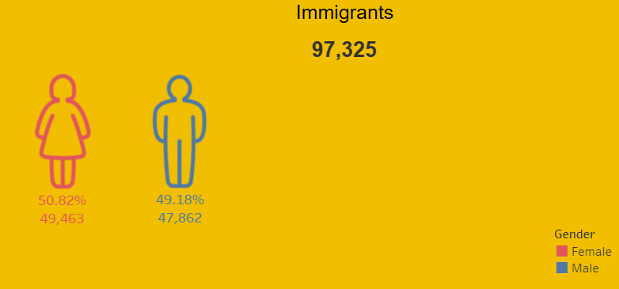
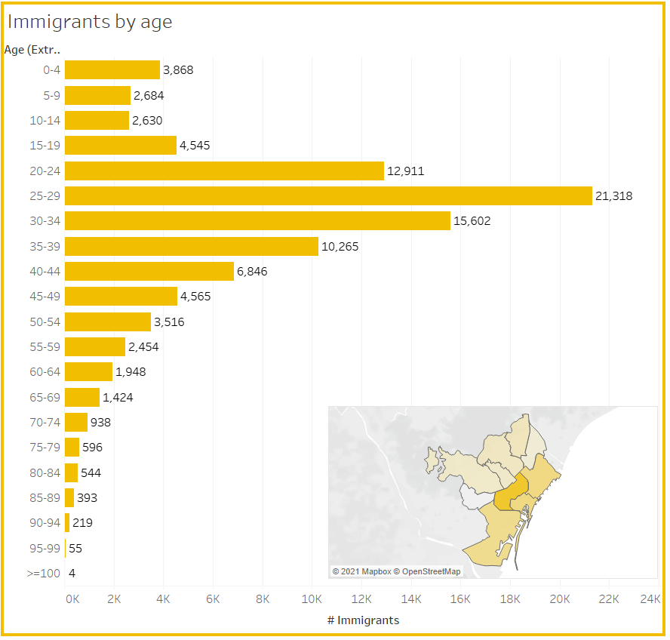
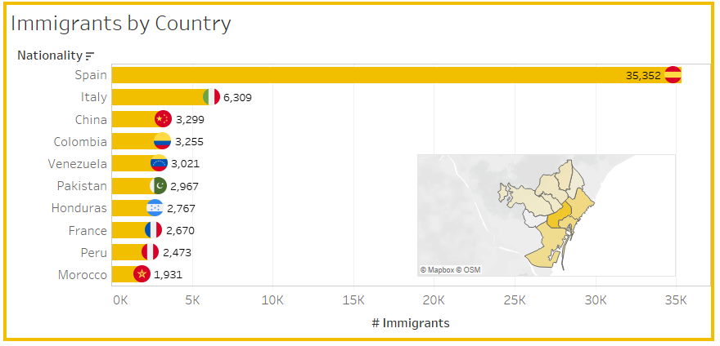
Immigrants
Immigrants by Age
Immigrants by Country
This chart is a KPI showing both the number of immigrants in the city and how they are distributed by their gender
This chart is composed by two parts:
A bar chart
A map
This particular choice was made in order to allow the user to analyze how the immigrants are distributed by their age in the various districts and vice versa.
Similar to the previous visualization, here, the number of immigrants by each nationality have been calculated.

Slide 32
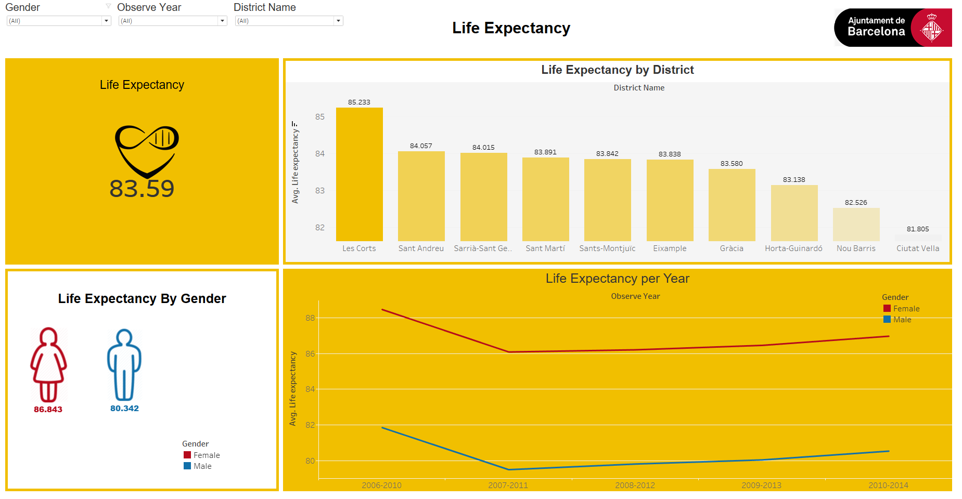
Life expectancy dashboard
This dashboard will focus in analyzing the life expectancy in Barcelona under various aspects like the gender and the districts
Dashboard contains:
The Filters, filter the whole dashboard per Observed Year, Gender and District.
The image contains the Logo of Barcelona and can act like a button that can send the user directly to the overview dashboard.
4 Charts that will be discussed later

Slide 33
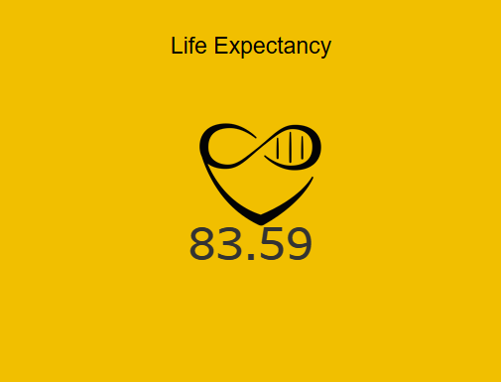
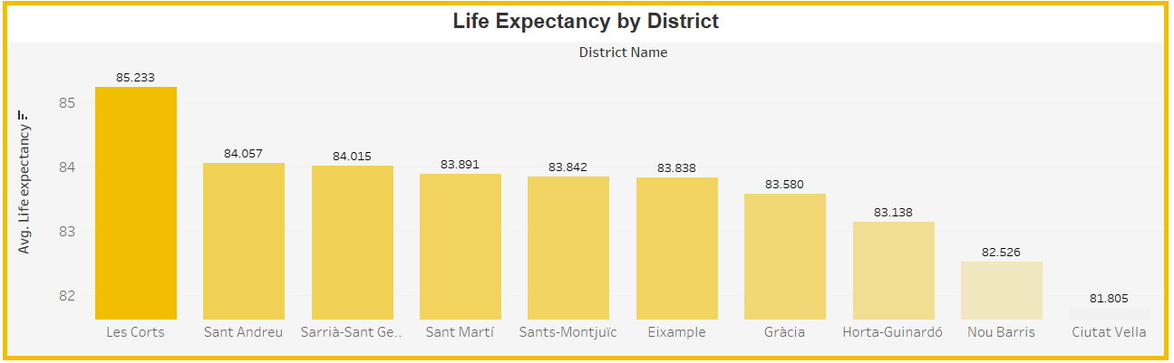
Life Expectancy
Life Expectancy by District
This KPI shows the average life expectancy of the situation identified by the filters.
This is a bar chart identifying the life expectancy in each district

Slide 34
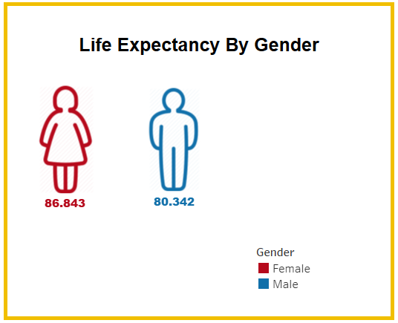
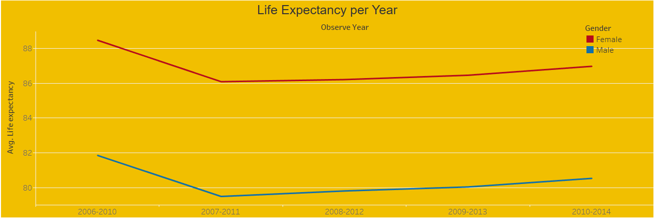
Life Expectancy by Gender
Life Expectancy by Year
This chart shows how the life expectancy changes by the gender
This chart is composed by two lines, one per each gender and shows how the life expectancy changed over the years.

Slide 35
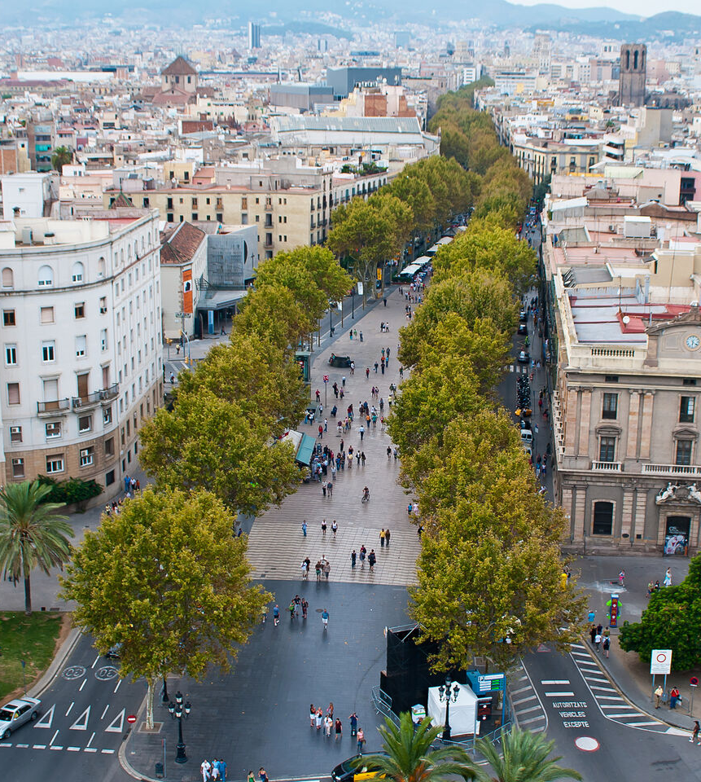
Final result

Slide 36
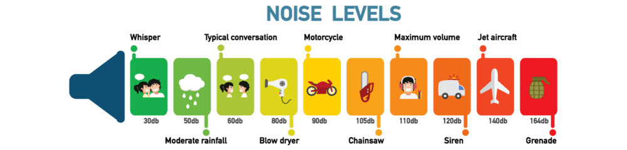
Conclusion 1
Looking at Demographic situation of city of Barcelona from 2013 to 2017 :
we can see population increased to 1,620,809 in 2017 which from this number 13,526 are newly born people in 2017 and 46,225 people died in this year
We can see that Barcelona has good Life quality since:
Majority of noise pollution in the city is in range 45-50 db which in the range of “Normal talking noise pollution”.
Overall Air quality of the city is Good.
Daily Bus is the regular transportation in the city.
Looking at Accidents number:
Number of Accidents during 2013 to 2017 is 56855.

Slide 37
Unemployment visualization shows us:
From 2013 to 2017 unemployment rate decreased from 30% to 12%.
About Life expectancy we can say that:
Life expectancy based on last population statistic is 83.59 years old.
Our visualization about Immigrants number describe us:
Number of immigrants in 2017 increased to 97325.
Conclusion 2

Slide 38
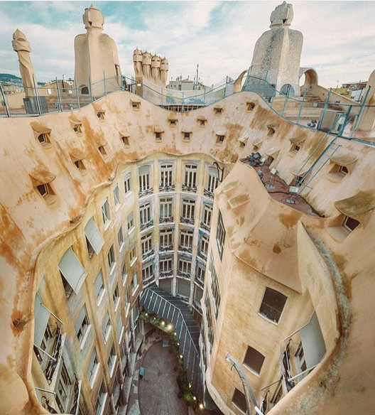
Color blindness test

Slide 39
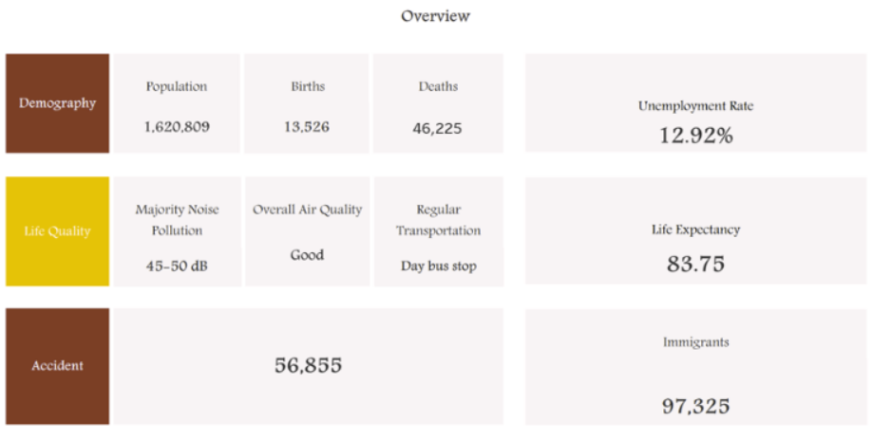
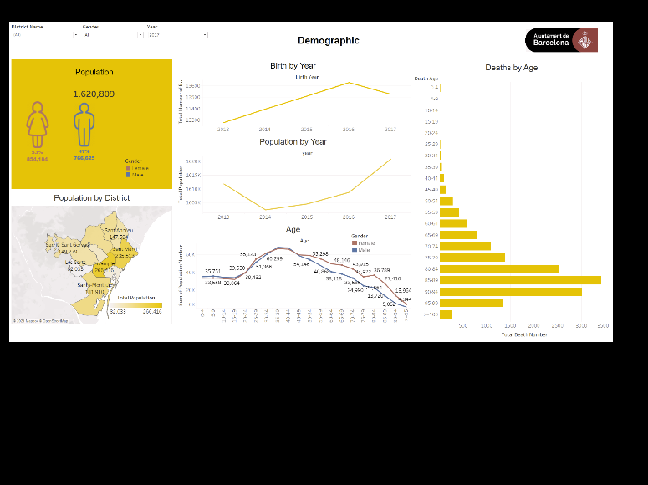
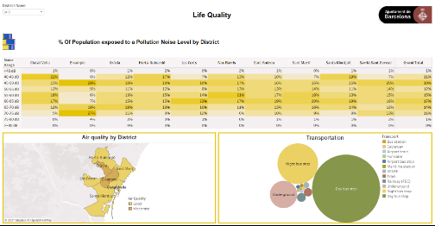
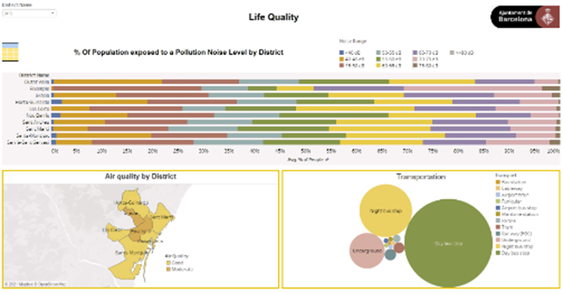

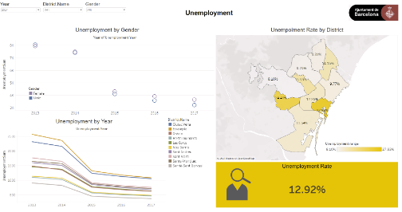










Anomalous Trichromacy
- Protanomaly: red-weak
- Deuteranomaly: green-weak
-Protanopia: red-blind

Slide 40
















- Tritanomaly: blue-weak
Dichromatic view
-Protanopia: red-blind
-Protanopia: red-blind

Slide 41
















- Deuteranopia: green-blind
- Tritanopia: blue-blind

Slide 42















Monochromatic
- Monochromacy/Achromatopsia
- Blue Cone Monochromacy

Slide 43

Grazie per l'attenzione

